Slide 1
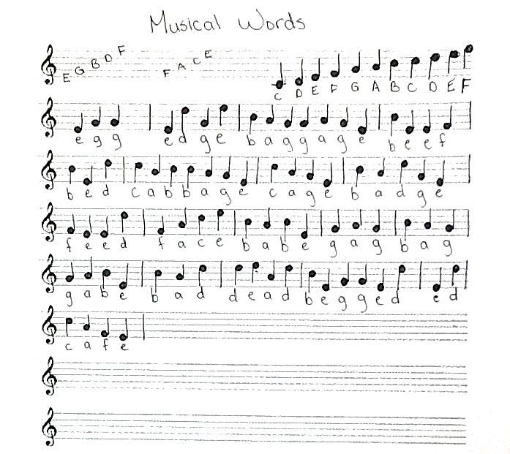
Abe Ace Add Ade Age
Bad Bag Bed Bee Beg
Cab Cad
Dab Dad
Ebb Egg
Fad Fed Fee
Gab Gag
Aged
Bade Bead Beef
Cafe Cage Cede
Deaf Deed Dead
Edge Egad
Face Fade Feed
gage
Added
Badge
Caged Ceded
Dabbed Decaf
Ebbed Egged Edged
Faced Faded
Gaffe
Badged Bagged Beade
Bedded Beefed Begged
Dabbed Deface
Efface
Gabbed Gaffed Gagged
Baggage
Cabbage
Defaced
Effaced

