Slide 1



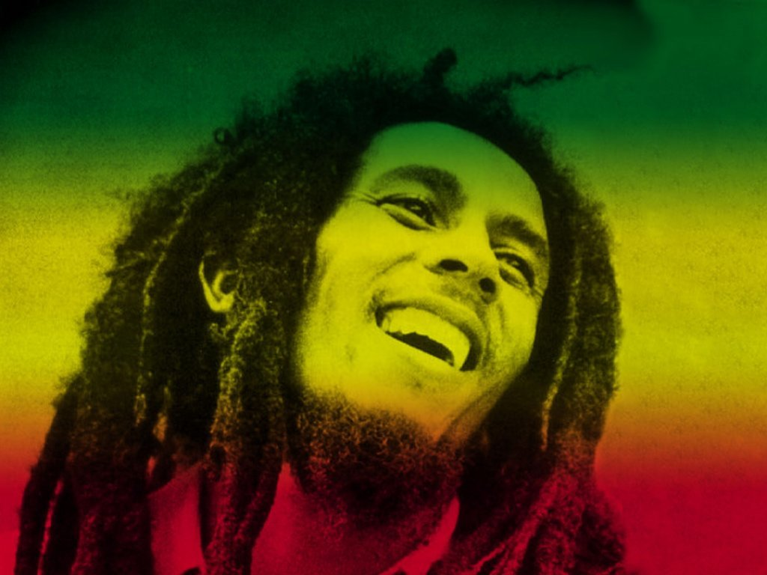
Reggae
Your own work
1

Slide 2

To Learn about Music in the Caribbean, including Reggae
To learn to play and sing
“3-Little-Birds”
Compose your own Reggae song with Ska chords, riff, and words

Slide 3
L.O;
To be able to construct and perform a 16-bar chord sequence for your own Reggae piece
W.I.L.F;
  Why is it 16 bars?
  How many different chords would we need?
  Why would the first and last chord be the same?
  How do the chords fit together?
2. To start adding words to form the melody line.
Key words; ska chords, back beat, syncopation, riff, hook

Slide 4
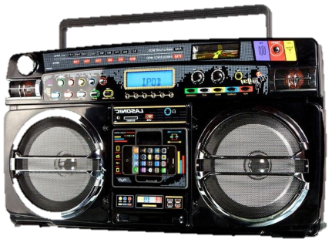

Examples of Reggae….

Slide 5
Start
 |  |  | end
Suggestions; G C D or C F G

Slide 6

Reggae music is the best
It stops me feeling low
And every time I get that feeling
I want the world to know
Don’t worry, don’t hurry
Gonna’ make me feel so good
The sun it shines down
I knew it always would

Slide 7
Riff….
Keep it simple;
don’t use a riff every bar
total pattern of 4 – 8 notes maximum, based
on 3 – 5 different notes

Slide 8
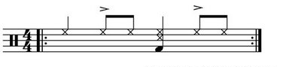
The percussion

Slide 9
