Slide 1


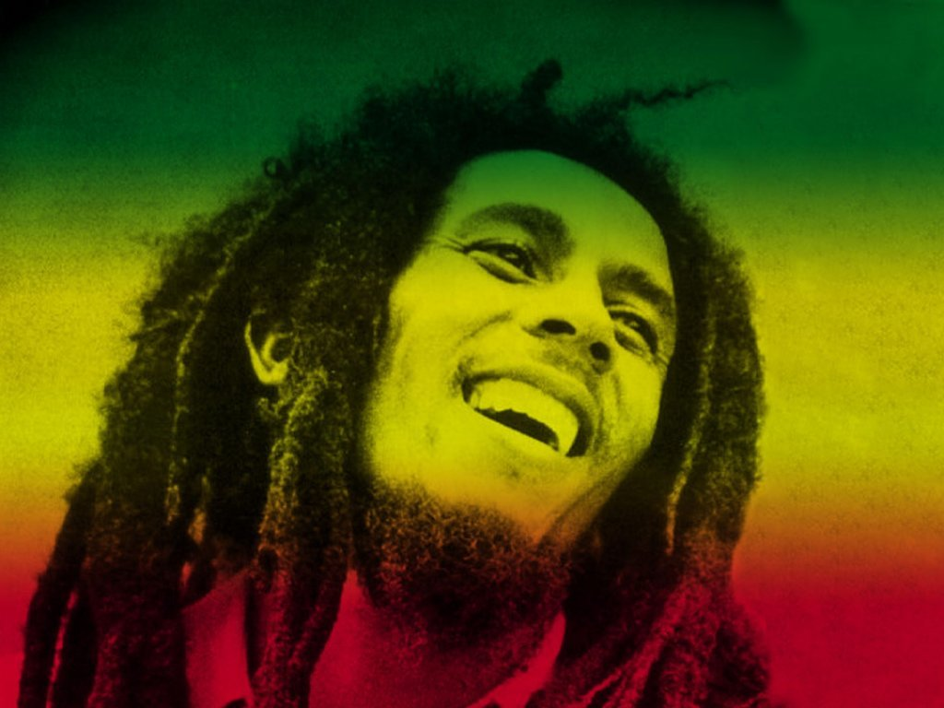
Reggae
Your own work

Slide 2

To Learn about Music in the Caribbean, including Reggae
To learn to play and sing
“3-Little-Birds”
Compose your own Reggae song with Ska chords, riff, and words

Slide 3
L.O;
To complete adding the words to form the melodic line to fit in with a 16-bar chord sequence for your own Reggae piece
To create a melody that works with the chords and the words
Key words; ska chords, back beat, syncopation, riff, hook

Slide 4
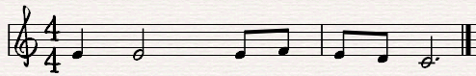
Melodic line
Syllabic Music writing;
One note for each syll-a - ble

Slide 5
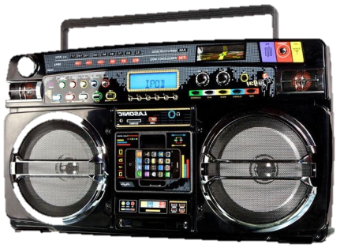

Examples of Reggae….

Slide 6
Start
 |  |  | end
Suggestions; G C D or C F G

Slide 7

Reggae music is the best
It stops me feeling low
And every time I get that feeling
I want the world to know
Don’t worry, don’t hurry
Gonna’ make me feel so good
The sun is shining down on me
I knew it always would

Slide 8
Melodic line
Syllabic Music writing;
One note for each syll-a - ble
One note for each syll-a - ble
One note for each syll-a - ble
That’s the way to write.

