Slide 1


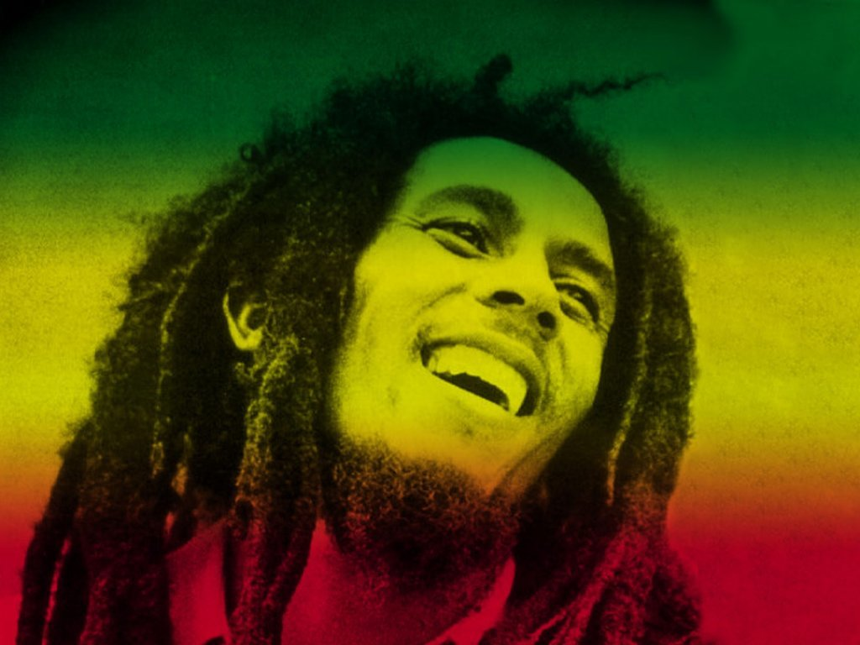
Reggae
Your own work

Slide 2

To Learn about Music in the Caribbean, including Reggae
To learn to play and sing
“3-Little-Birds”
Compose your own Reggae song with Ska chords, riff, and words

Slide 3
L.O;
Start to fit in a rhythmic percussion pattern to fit in with your piece of music
To put all the elements together to complete your piece
Key words; ska chords, back beat, syncopation, riff, hook

Slide 4
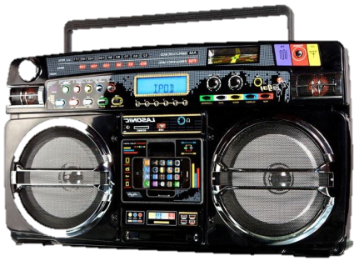

Examples of Reggae….

Slide 5

Reggae music is the best
It stops me feeling low
And every time I get that feeling
I want the world to know
Don’t worry, don’t hurry
Gonna’ make me feel so good
The sun is shining down on me
I knew it always would

Slide 6
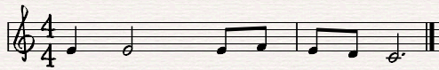
Melodic line
Syllabic Music writing;
One note for each syll-a - ble

Slide 7
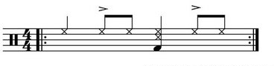
The percussion

Slide 8
