Slide 1
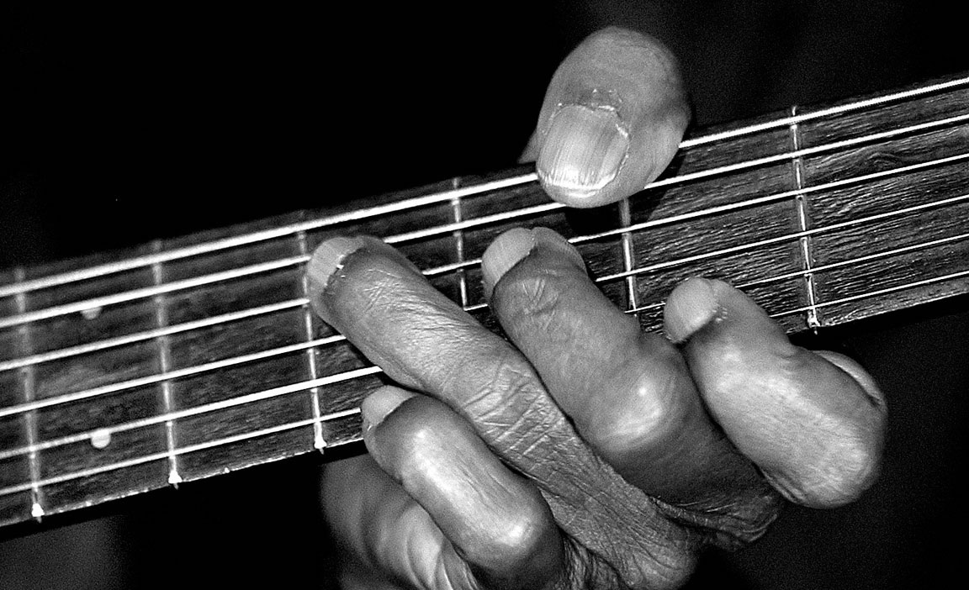
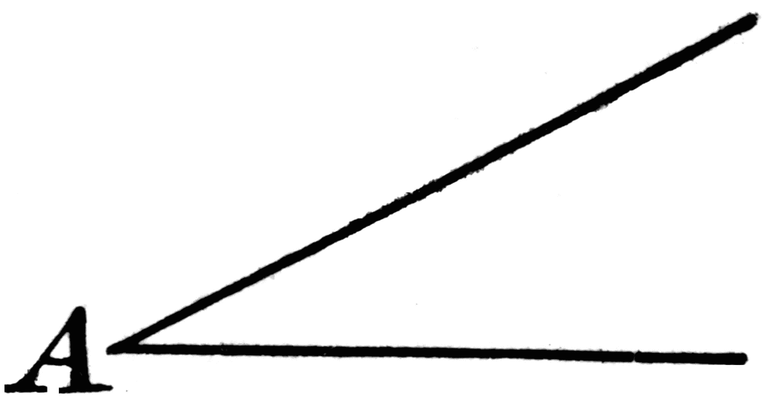
The 4 Chord Trick

Slide 2
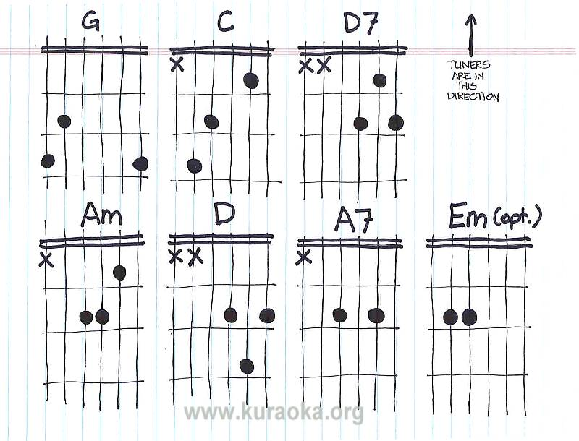
The 4 Chord Trick

Slide 3
The G Chord
3
1
2

Slide 4
The D Chord
2
3
1
3
2

Slide 5
The Em Chord
1
2
3

Slide 6
The C Chord
1
2
3

